Slide 1
THE GEOPOLITICS OF LAW
Vietnam’s position
Singapore, 26th June 2019
NGUYEN MANH DZUNG
DIRECTOR| ADR VIETNAM CHAMBERS LLC
MEMBER | ICC INTERNATIONAL COURT OF ARBITRATION

Slide 2
INTRODUCTION
Notes:
https://iccwbo.org/dispute-resolution-services/arbitration/icc-arbitral-tribunals/
718Apr-2018
Dang Xuan Hop Vietnam Co-arbitrator Claimant(s) Active Pending
718Apr-2018
Nguyen Ngoc Bich Vietnam Co-arbitrator Respondent(s) Active Pending

Slide 3
INVESTMENT CLIMATE
Foreign direct investment to Vietnam by country as of 20 May 2019
Notes:
http://www.mpi.gov.vn/Pages/tinbai.aspx?idTin=43230&idcm=54
https://img.vietnamfinance.vn/upload/news/hoanghung_btv/2019/5/27/bai-cao-tinh-hinh-fdi-5-thang-dau-nam-2019.pdf

Slide 4
TOP TRADING PARTNERS OF VIETNAM IN THE FIRST FOUR MONTHS OF 2019
Notes:
.
http://www.gso.gov.vn/default.aspx?tabid=629&ItemID=19108

Slide 5
CHINA INVESTMENT TO VIETNAM
Foreign direct Investment from China to Vietnam in the first five months of 2019
New registered Project | New Registered Capital (million USD) | Number of Projects increasing Capital | Additionally Registered Capital (million USD) | Number of Turns of contributing capital and purchasing shares | Value of capital contributed and shares purchased | Total Registered Capital (million USD)
233 | 1,561.45 | 46 | 125.05 | 540 | 334 | 2,020.68
2. Main industry sectors of investment
Manufacturing and processing
Energy
Real Estate
Others
Notes:
China is the largest importer to Vietnam, and Vietnam’s third largest export market.
http://www.gso.gov.vn/default.aspx?tabid=629&ItemID=19108
https://img.vietnamfinance.vn/upload/news/hoanghung_btv/2019/5/27/bai-cao-tinh-hinh-fdi-5-thang-dau-nam-2019.pdf

Slide 6
Export – Import Turn-over between Vietnam and China in the first four months of 2019
CHINA INVESTMENT TO VIETNAM
Import value to Vietnam | Export value from Vietnam
22,770,941,000 USD | 10,469,308,000 USD
Notes:
China is the largest importer to Vietnam, and Vietnam’s third largest export market.
http://www.gso.gov.vn/default.aspx?tabid=629&ItemID=19108
https://img.vietnamfinance.vn/upload/news/hoanghung_btv/2019/5/27/bai-cao-tinh-hinh-fdi-5-thang-dau-nam-2019.pdf

Slide 7
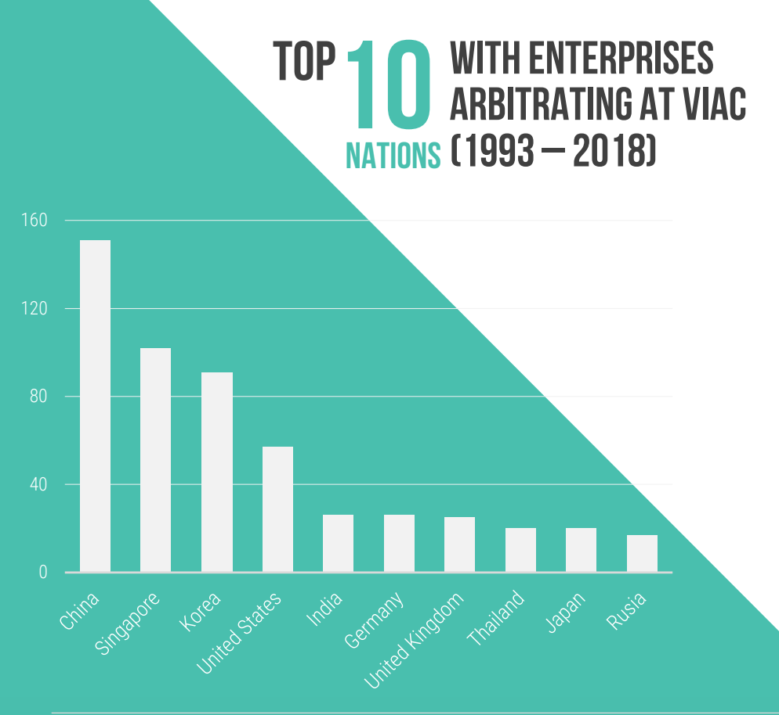
TOP USERS OF ARBITRATION IN VIAC
Source: VIAC 2018 Annual Report
Notes:
VIAC 2018 Annual Report

Slide 8
BITS, FTAS SIGNED BY VIETNAM
Source: https://investmentpolicyhub.unctad.org/IIA/CountryOtherIias/229#iiaInnerMenu
Notes:
Source: https://investmentpolicyhub.unctad.org/IIA/CountryOtherIias/229#iiaInnerMenu
FTAs:

Slide 9
THANK YOU FOR YOUR ATTENTION!
Q
&
A
ADR Vietnam Chambers LLC
Add: Level 46, Bitexco Financial Tower, No.2 Hai Trieu Street,
Ben Nghe Ward, District 1, Ho Chi Minh City, Viet Nam
Tel. +(84) 903 807 376
Email: dzung.nguyen@adr.com.vn
Web: www.adr.com.vn

